Slide 1
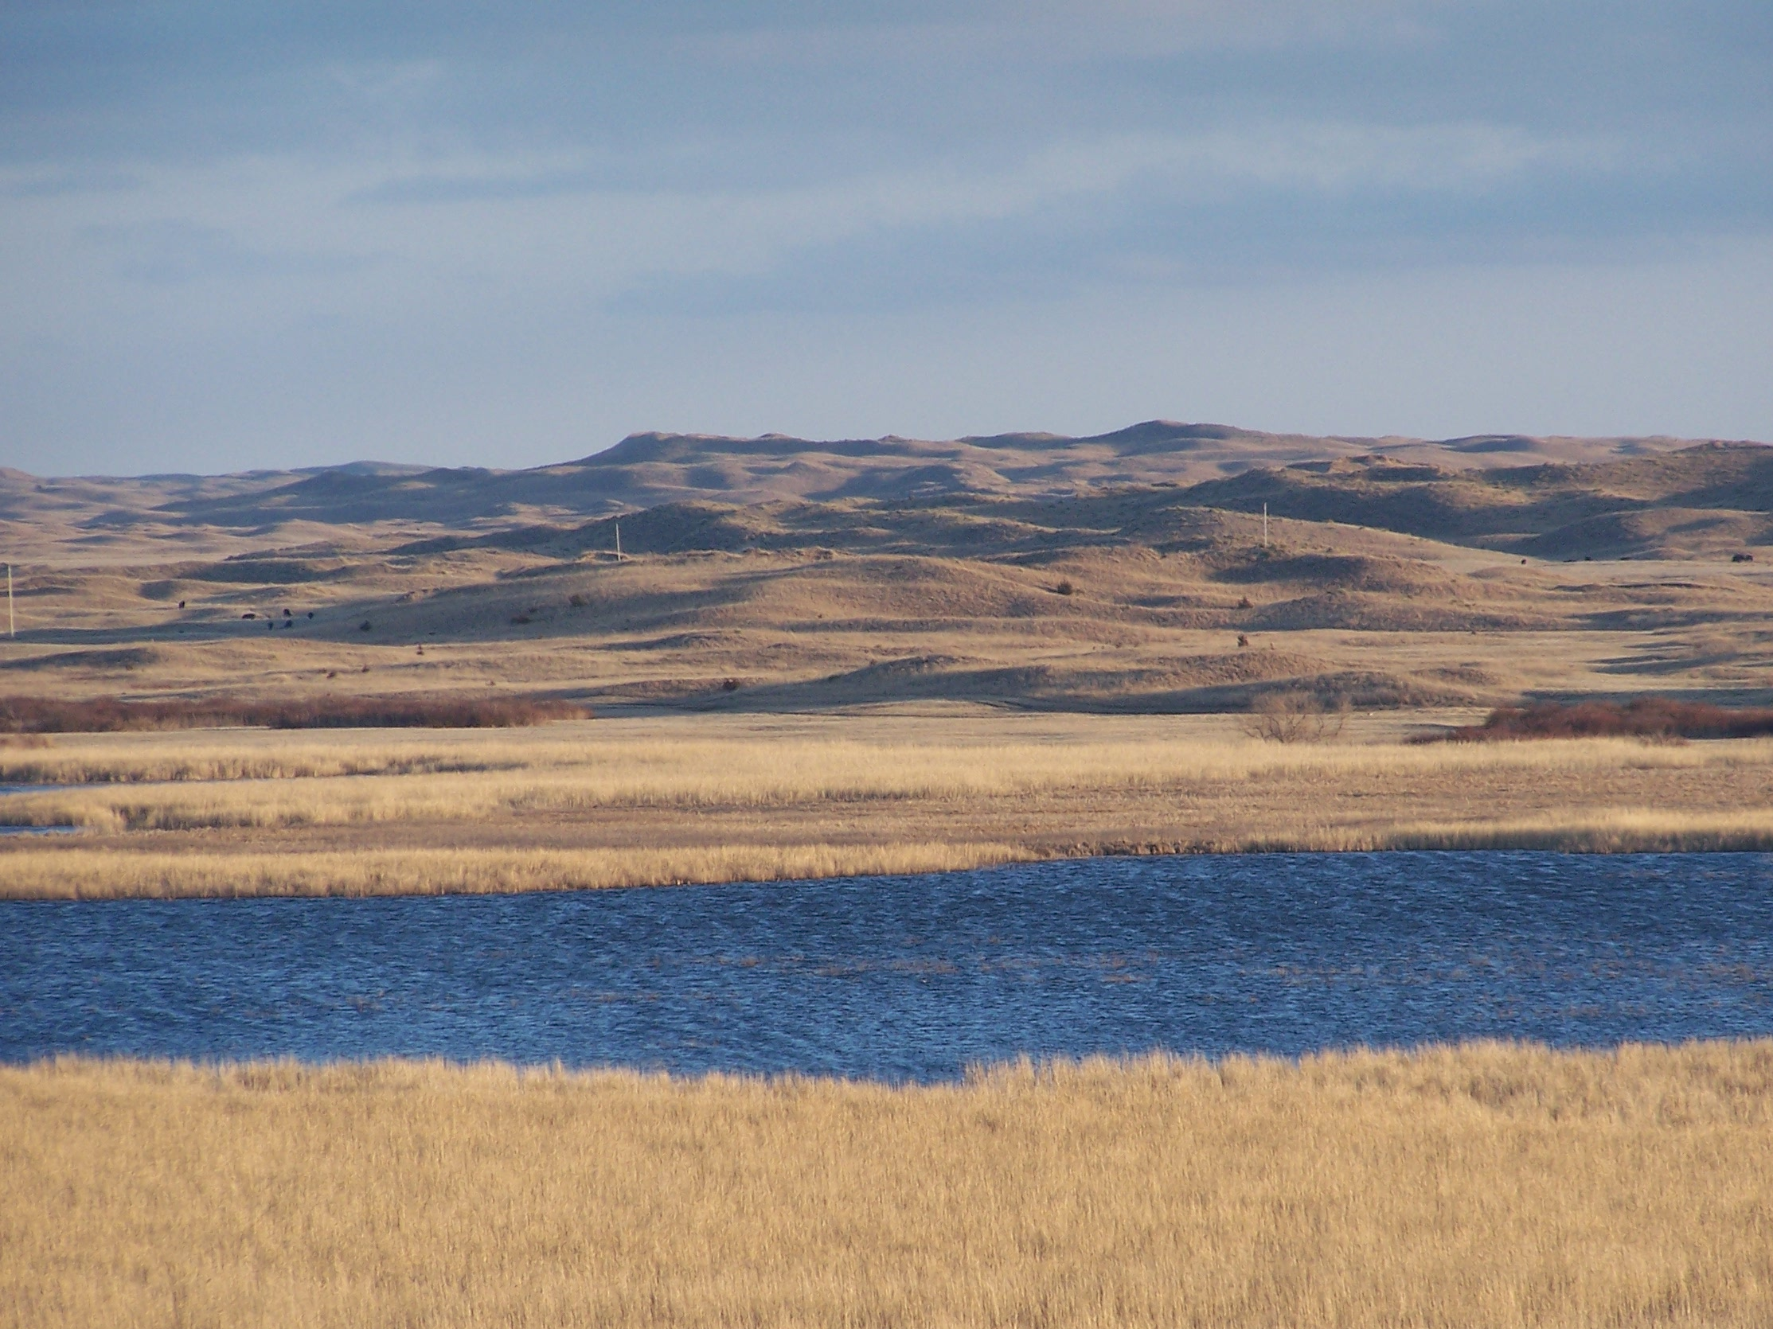
Natural Selection in the Nebraska Sand Hills
Notes:
BLURB:
To explore the basic concept of natural selection, this presentation employs Hoekstra Laboratory research on cryptic coloration in wild mice of Nebraska as a an example study system. It is intended for students in introductory or advanced high school biology classes, and will work well as a complement to basic lessons in genetics and evolution.
The short version of the presentation includes the lab’s observations of variation, heritability, and differential fitness in populations of light and dark mice living on adjacent light and dark soil types, respectively. It is intended to give students a “real-life” example of adaptation and of research in the field of evolutionary biology.
The longer version includes the initial shorter presentation, but then continues on with examples of specific experiments performed by Hoekstra Lab members to demonstrate the action of natural selection in this particular system. The intent is to demonstrate the use of ongoing, modern science to address fundamental questions regarding the mechanism of natural selection. This portion of the presentation can be given in two ways:
The instructor may present the Hoekstra Lab’s methods and findings, or may present the methods, discuss them with students, and then supply the students with raw data sets to analyze in small groups (please see links below for data and analysis suggestions). If the latter choice is taken, students may then be asked to prepare presentations of their findings, and to compare these with those of the Hoekstra Lab.
SLIDE 1 NOTES:
The Nebraska Sand Hills are a unique dune habitat formed by sand which eroded off of the rocky mountains within the last 8-15,000 years. A species of wild rodent, the deer mouse (Peromyscus maniculatus) lives both on these light sand dunes and on the much darker surrounding soil. The Hoekstra Laboratory is a group of scientists that study these mice in Nebraska and in many places across the country, looking at how natural selection can cause adaptations to local conditions.

Slide 2
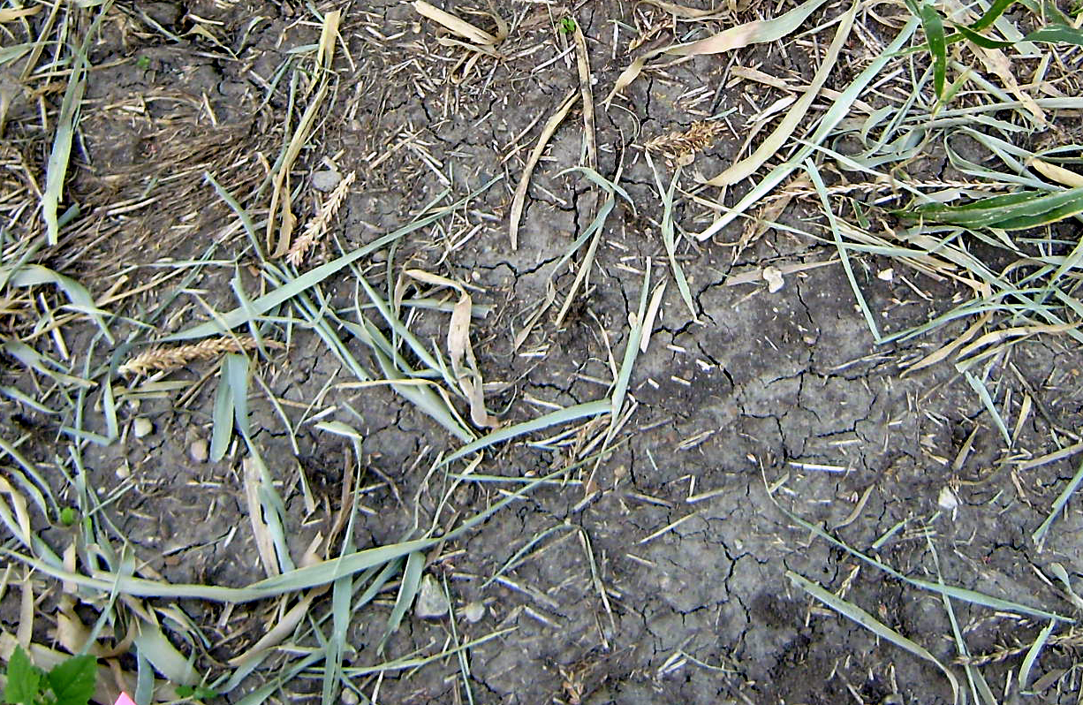
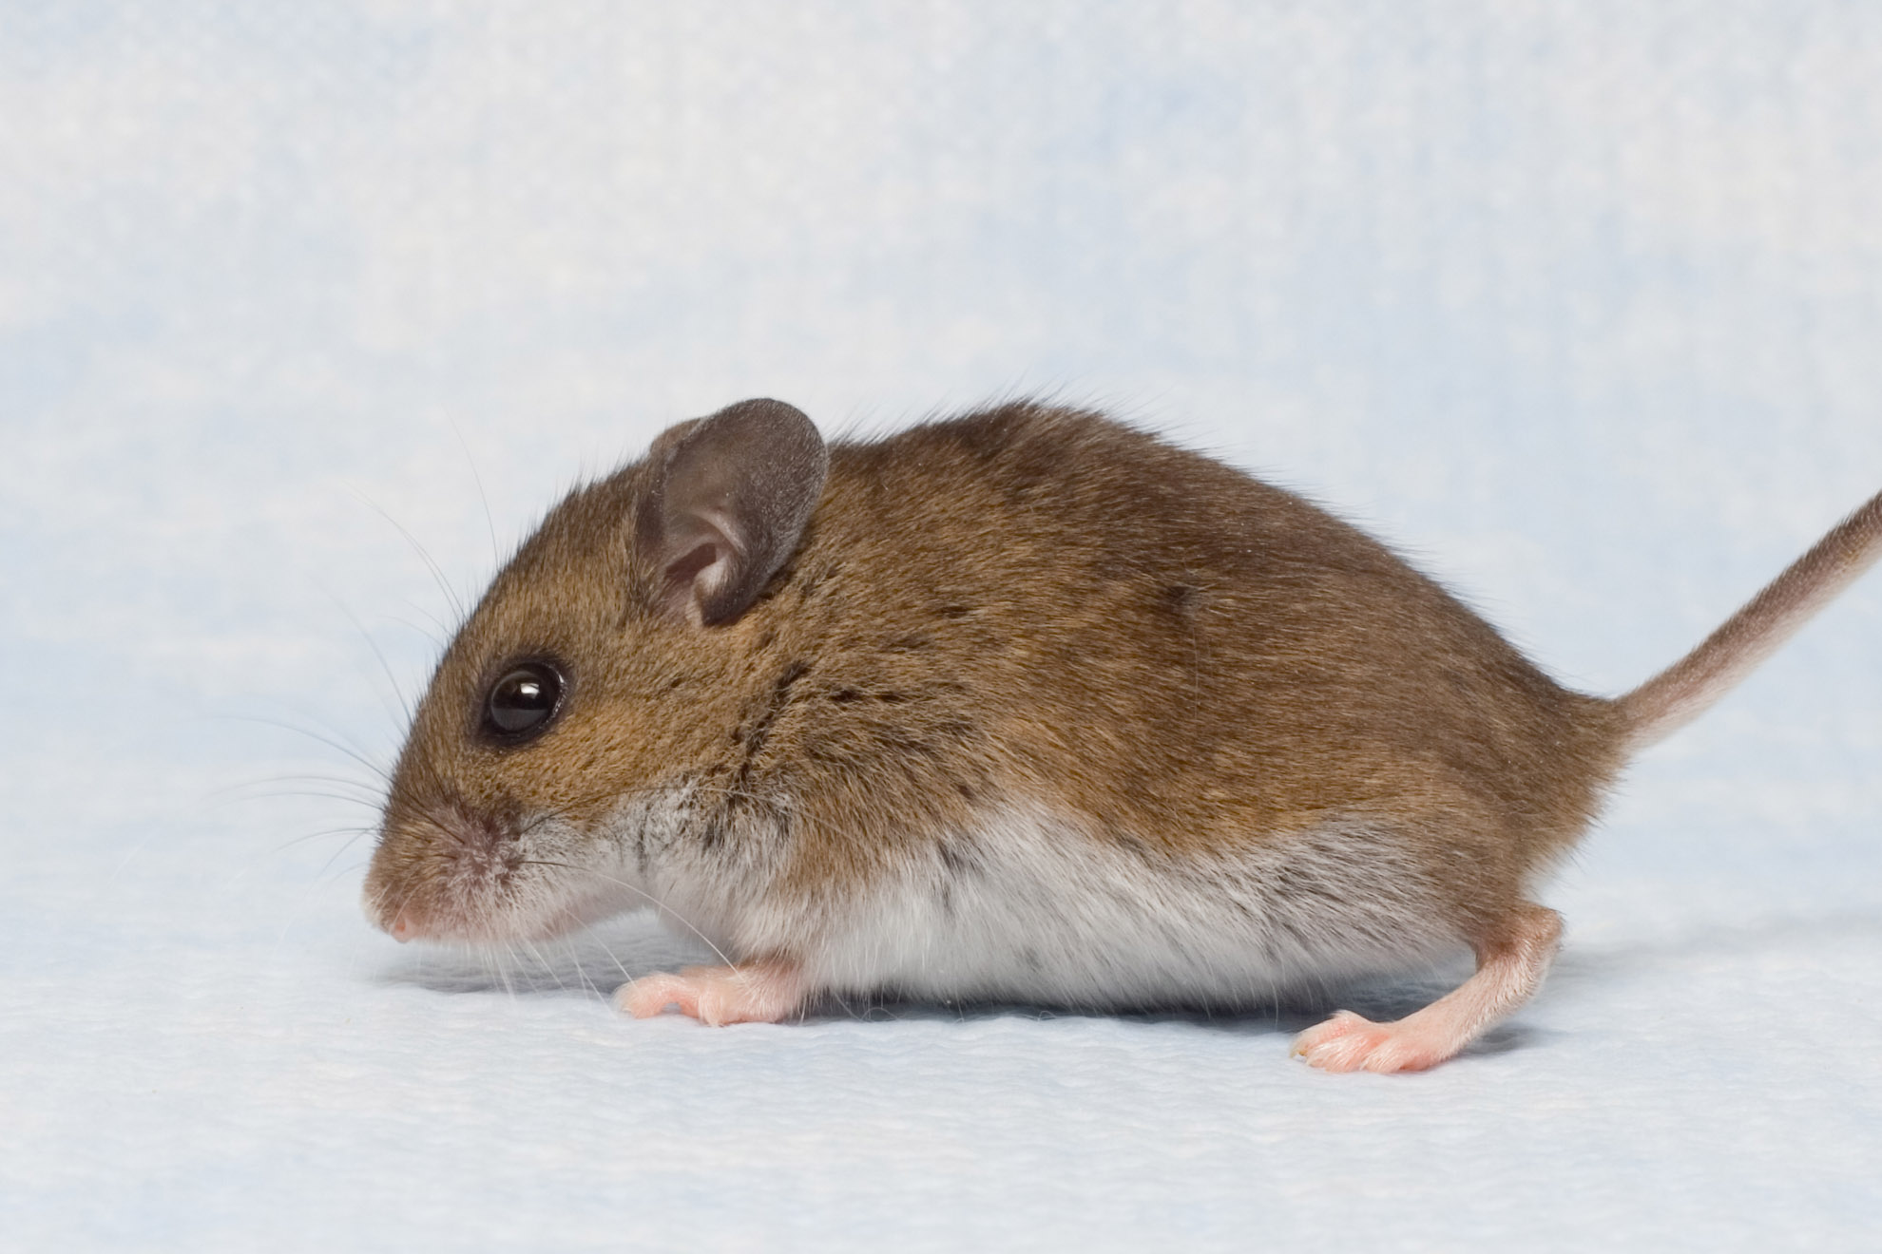
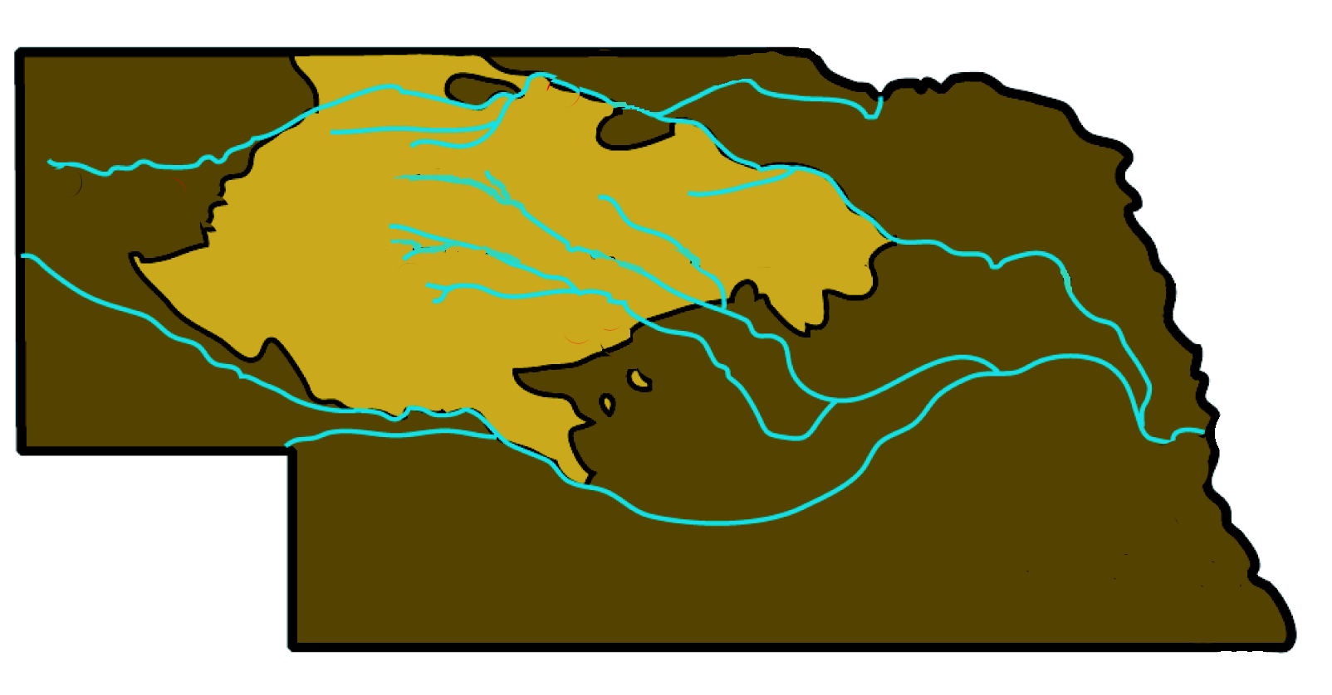
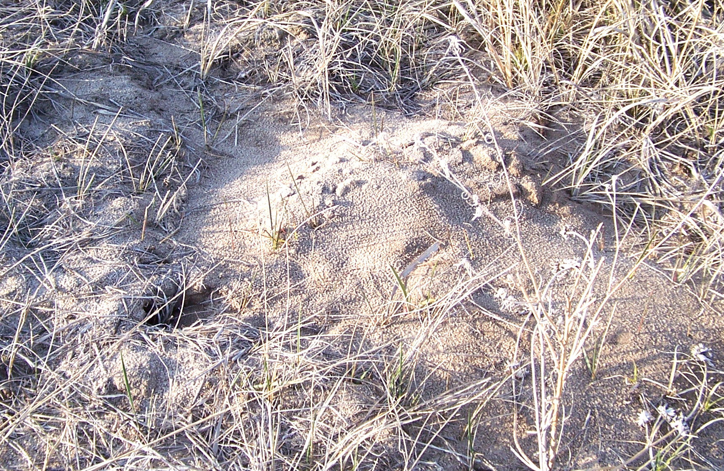
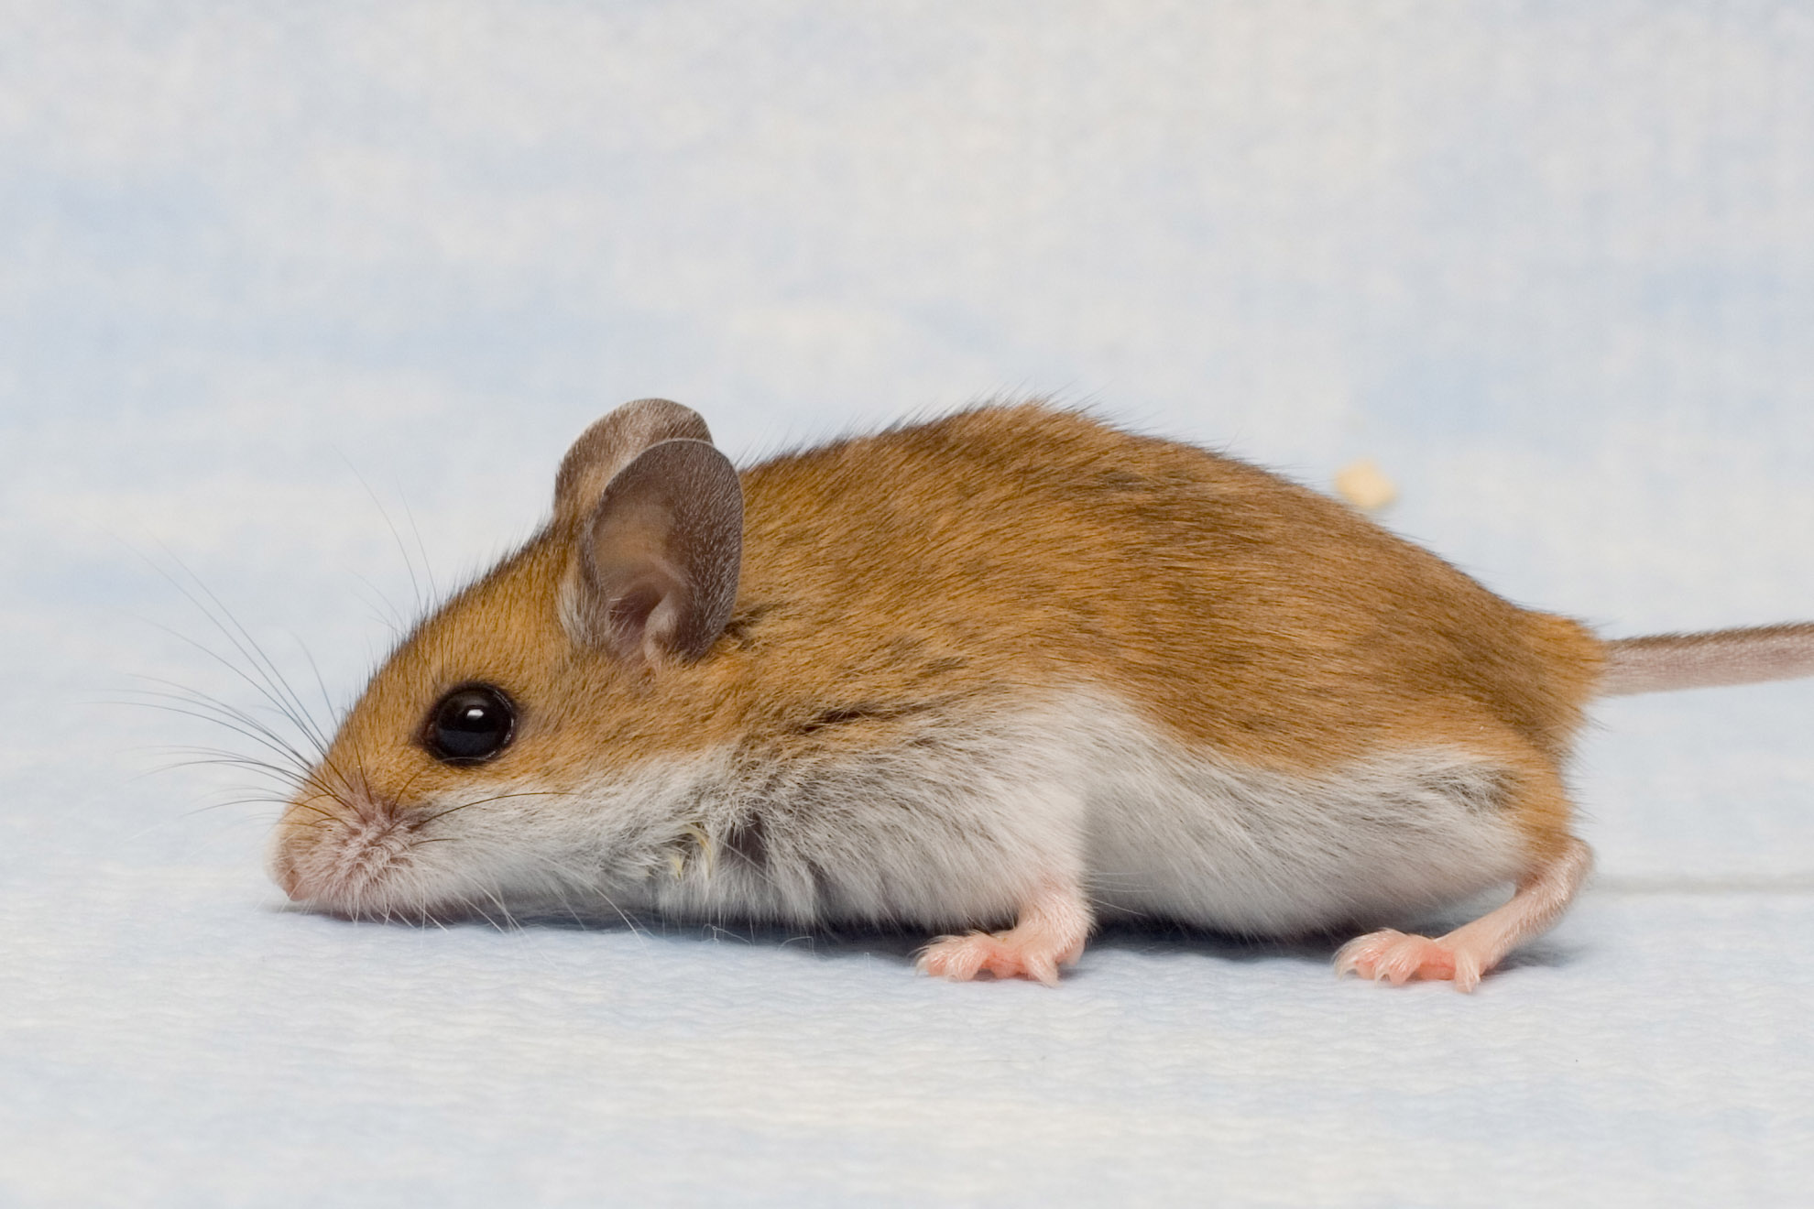
Observation:
Dark soil
Dark mice
Nebraska
Light sand
Light mice
50km
…an adaptation?
Notes:
SLIDE 2 NOTES:
The Hoekstra Lab’s study began with an observation made previously: that mice living on the dark soils surrounding the Sand Hills are dark brown in color, but mice living on the light sands are much lighter. The two kinds of mice are considered to be the same species, they can mate with each other when they meet on the Sand Hills borders, and they are not obviously different in characteristics aside from their fur. The Hoekstra Lab wondered whether light coat color on light sands could be an adaptation – a genetic change in these mice that enables them to better survive in their environment. Given that in evolutionary time, the Sand Hills are quite young (just 8-15,000 years old), if the change in coat color happened as a result of mice colonizing the light soil, it happened recently and quickly!
But hypothesizing a story in which adaptation took place is not the same as studying or proving it. The Hoekstra lab therefore went on to examine whether or not light coat color on light sands was indeed an adaptation of these mice to their environment.

Slide 3
Adaptation happens by…
Natural Selection:
1. Variation
2. Heritability
3. Differential fitness
Notes:
SLIDE 3 NOTES:
Adaptation, in the evolutionary sense, involves a genetic change that enables an organism to better survive and reproduce in its current environment. And adaptation happens by natural selection. Natural selection is a simple process, and it is nearly inevitable if a few basic requirements are met:
First, there must be variation in some trait. In this case, we’re talking about mouse’s coat color, but it could be many other characteristics – visual acuity, food preference, foot length, ability to digest a certain plant, ability to produce a toxin, the list goes on… (Opportunity to brainstorm as a class: Can you think of other examples of variation? What is some variation that you have seen in organisms from your own community (try to get breadth – animals, plants, fungi, bacteria)?)
Second, this variation must be at least partially heritable. For the mice, this means that the difference between light and dark coat colors is due at least in part to a genetic difference. Some traits like height are partly determined by genetics (children are usually not wildly taller or shorter than the average of their parents) and partly by the environment (nutrition can make a big difference to height, too). (Opportunity for discussion: For the variable traits you listed above, which are probably genetic? Which are probably due to the influence of the environment? Which are both?)
Finally, the heritable variation in a trait must lead to differences in fitness. Here we are not talking about physical fitness, but about biological fitness – the tendency to survive and reproduce in a given environment, thereby passing on one’s genes. In this example, mice inheriting a particular coat color from their parents must be better at surviving and passing on that coat color to their offspring in a particular environment.
This last step is important because it ties the process together – if organisms inheriting a particular variation of a trait are more likely to contribute to the next generation, the number of individuals down the road with that particular variation will increase, and the population as a whole will start to change. (Opportunity for discussion: For the traits you identified that are both variable and heritable, which ones do you think became common because they gave a fitness advantage to certain organisms in certain environments? What kind of advantage?)
But to return to the big picture, the Hoekstra Lab initially hypothesized that light coat color on light sand was an adaptation. To prove this, they needed to examine all three components, variation, heritability, and differential mortality, in greater detail.

Slide 4
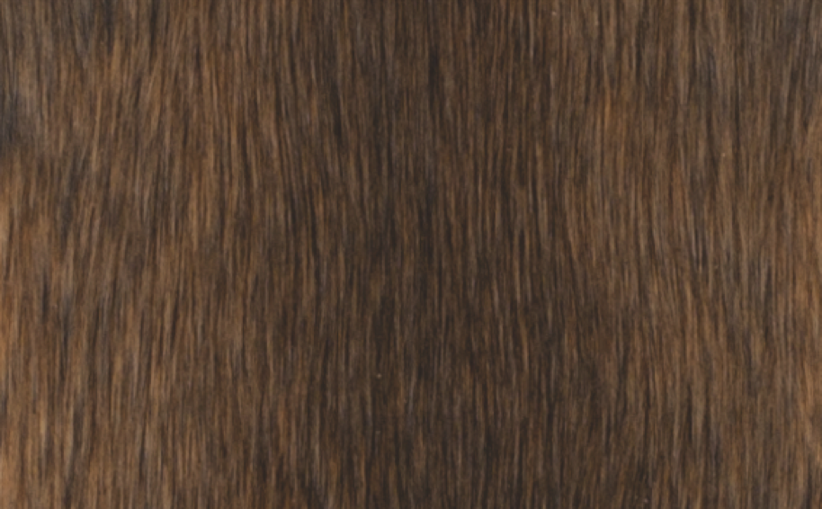
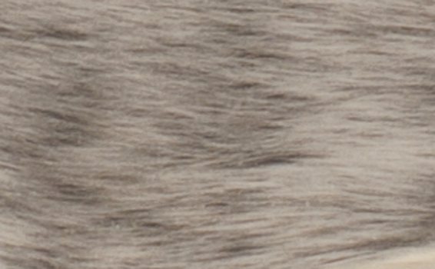
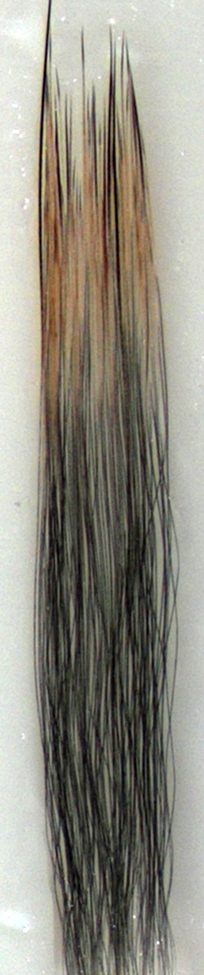
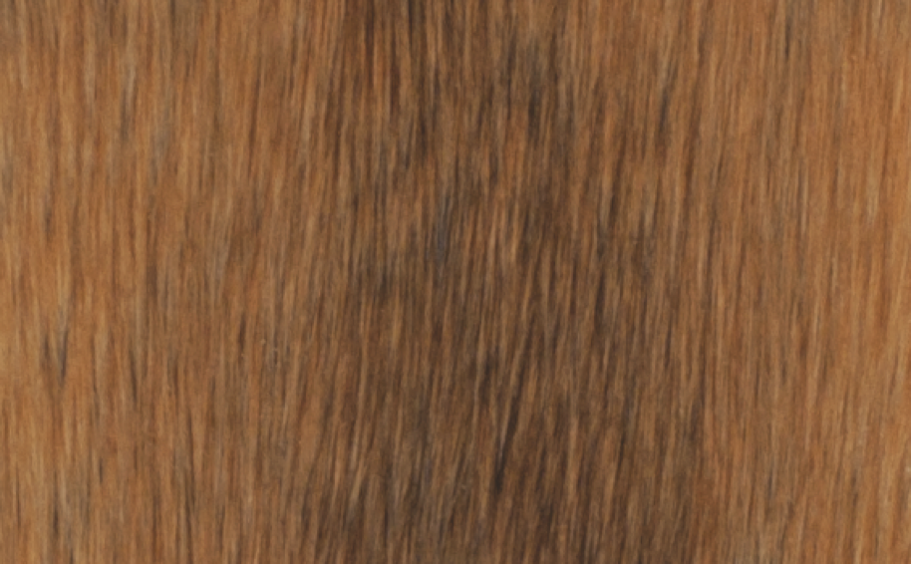
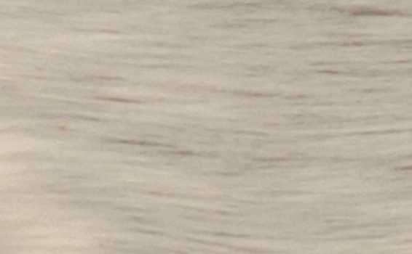
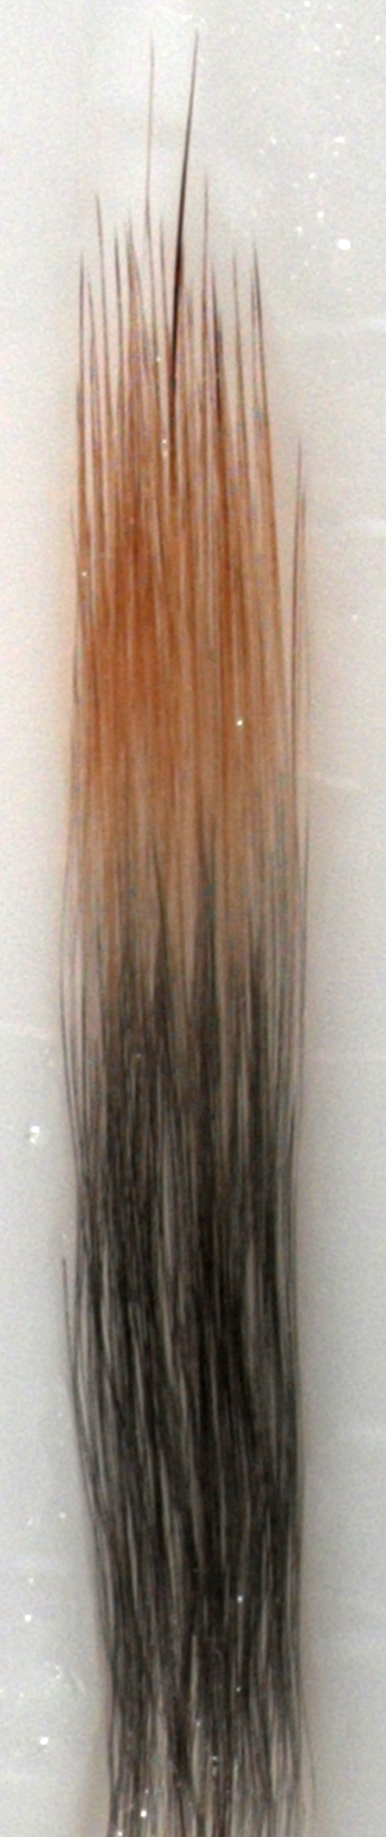
1. Variation:
Dark Mice
Nebraska
Light Mice
50km
Notes:
SLIDE 4 NOTES:
First, Hoekstra Lab members went about quantifying the differences in mouse coat color on both light and dark soils. They measured a number of different traits – overall color of the mouse’s back and belly, as well as the banding pattern on the mouse hairs themselves.
They observed many differences between the animals living on dark soil and light sand – soil mice had dark brown backs, grey bellies, and black hairs with a small brown tip. Sand hills mice had orange-golden backs, nearly white bellies, and black hairs with a large orange-golden tip.
In summary, there was a bunch of variation in the coats color of these mice, so the first criteria for natural selection was fulfilled.

Slide 5
2. Heritability:
Parent genes
Offspring color
Light/Light (AA)
Dark/Dark (aa)
=
Light | Dark | Ratio
42 | 0 | 1:0
Light/Dark (Aa)
Dark/Dark (aa)
=
Light | Dark | Ratio
51 | 50 | 1:1
Light/Dark (Aa)
Light/Dark (Aa)
=
Light | Dark | Ratio
42 | 15 | 3:1
Notes:
SLIDE 5 NOTES:
Next, the Hoekstra Lab wanted to know whether differences in coat color were heritable. To answer this question, they brought both light and dark colored mice into the lab, and allowed them to mate. They then observed the coat colors of offspring from various parents. (Opportunity for review: now is a great time to have students draw Punnett squares on the board! Ask them to determine the genotype (AA: Aa: aa) ratios in the offspring of each cross, and then to determine what phenotype (color) patterns these offspring should have if the trait is determined by a single gene and light coat color is A) dominant, B) recessive, or C) additive. Compare these results to the Hoekstra Lab’s results to determine that the allele for light coat color must be dominant).
The Hoekstra Lab measured the offspring color from each of these genetic crosses, and deduced that light coat color is dominant and determined by a single gene. Thus, the first two criteria for natural selection have been met: there is variation in mouse coat color and that variation is heritable.

Slide 6
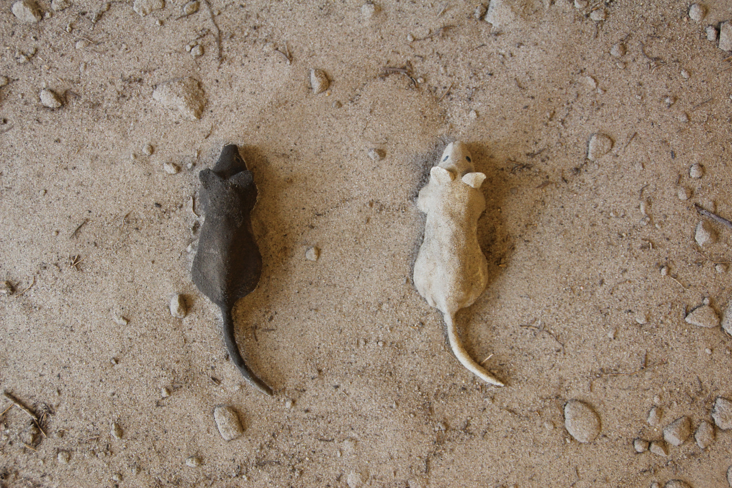
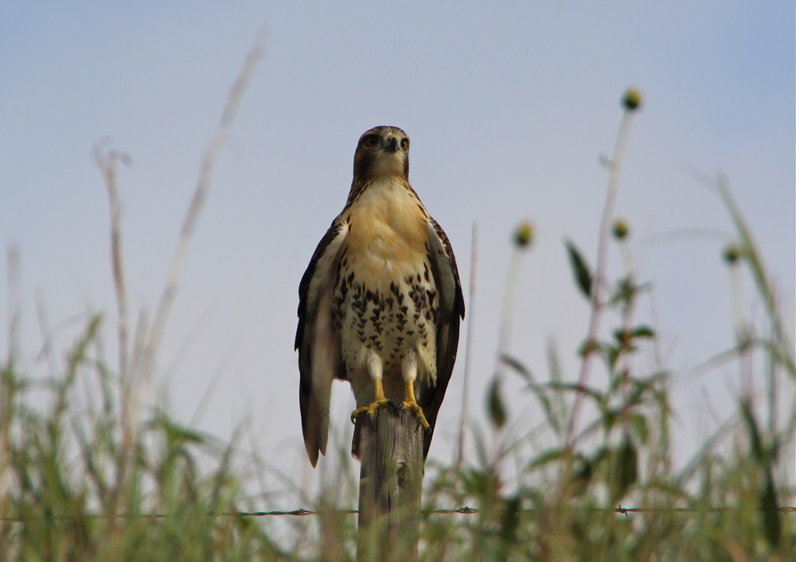
3. Differential Fitness:
Models Attacked:
Match
Mismatch
Notes:
SLIDE 6 NOTES:
Finally, the Hoekstra lab set about to find out whether the heritable variation in coat color might somehow lead to differences in survival. They hypothesized that having a light-colored coat on the light sand might help mice to escape predation. To test this hypothesis in a controlled way, Hoekstra Lab members made hundreds of non-drying clay mouse models, and spray-painted half of them dark and half of them light. They placed these models on the Sand Hills and checked periodically to see which of them had been attacked – the non-drying clay clearly showed the presence of beak, tooth, and talon marks from a variety of predators - owls and hawks but also kestrels, falcons, and occasionally kites. They then tallied up the number of attacks on light vs. dark mice, and found that over three-quarters of the attacks were against the models that did not match the light sands. If these models had been real mice, those that were attacked, especially at a young age, would never go on to reproduce. Because the mice that were attacked were mostly dark-colored, this would mean that, over many generations, the number of light mice on the Sand Hills would increase, and the number of dark mice would decrease.
(Opportunity for discussion: what are some of the advantages and disadvantages of using models instead of real mice? [Models differ only in color, and not in other factors that might also be under selection, and models are easier to control and count, but models may not fool most predators because they fail to move, smell, etc. like real mice]).

Slide 7
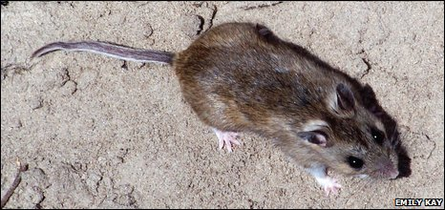
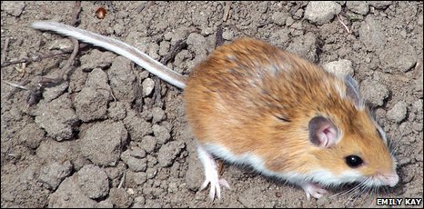
Natural Selection Summary
Variation
Heritability
Differential
Fitness
Light | Dark | Ratio
42 | 0 | 1:0
Light | Dark | Ratio
51 | 50 | 1:1
Light | Dark | Ratio
42 | 15 | 3:1
Notes:
SLIDE 7 NOTES:
With a few simple observations and experiments, it was possible to move from a hypothesis to a much more complete understanding of natural selection on mice in the Nebraska Sand Hills. Members of the Hoekstra lab confirmed 3 key facts: first, that there was variation in mouse coat-color which correlated with soil type; next, that this variation was heritable; finally, that this heritable variation led to differences in mortality, and therefore in the opportunity for mice to pass on their genes for coat color to the next generation.
(Opportunity for practice: of the heritable variations that you brainstormed at the beginning of class, do you think that any would cause differential fitness in a particular environment? Can you hypothesize a complete story of natural selection regarding this trait? What experiments might you do to tell whether or not your hypothesis was correct?)

